Slide 1
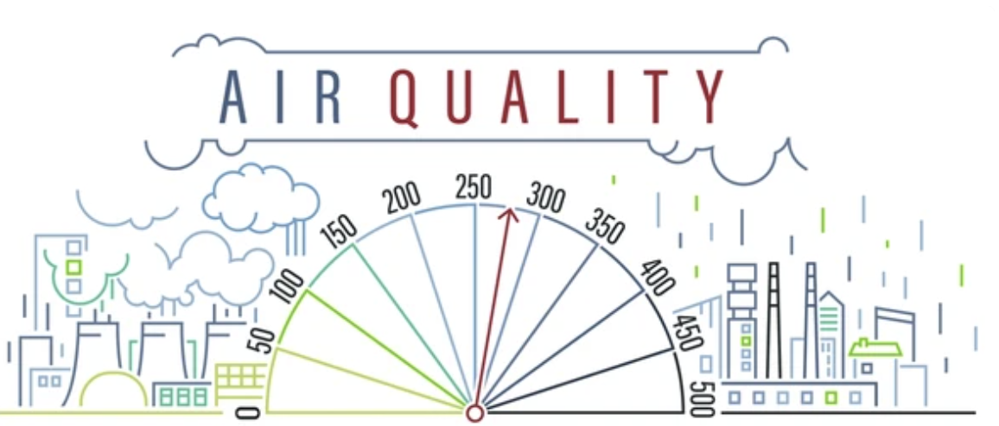
Unveiling U.S. Air Quality Dynamics through AWS Insights
Presented By:
Anagh Sharma
Aniket Tripathi
Mohit Kosekar
Niyanta Pandey
Priya Tinna
Rujhan Maniktalia

Slide 2
Project Scope
Problem Statement: Air pollution poses a significant threat to public health, yet readily available data often remains unexplored. By delving into the rich details captured in daily AQS summaries, we can move beyond basic understanding and identify actionable insights to inform decision-making.
High Level Solution:This project aimed to address air pollution concerns by uncovering patterns and identifying problematic areas. Data from 2022 (API) and 2023 (CSV) was merged, cleaned, and loaded into an OLTP database. The database was then transformed for OLAP analysis, allowing visualization of trends in a fact table. This system facilitates the identification of concerning areas and potential prediction of future trends.

Slide 3
Project Milestones and Timeline
S.N | MILESTONES | Timeline
1 | Daily Air Quality Data Obtained from 2 sources: API for 2022 and CSV for 2023 | February 7 - February 18 (2 weeks)
2 | Data Cleaning and Merging (AWS Lambda) | February 21 - March 4 (2 weeks)
3 | Uploading the merged files to an RDS instance | March 5 - March 18 (2 weeks)
4 | Normalizing the initial database | March 19 - April 1 (2 weeks)
5 | OLTP to OLAP AWS Glue | April 2 - April 15 (2 weeks)
6 | Data Visualization | April 16 - April 30 (2 weeks)

Slide 4
DELIVERABLES | ANAGH SHARMA | ANIKET TRIPATHI | MOHIT KOSEKAR | NIYANTA PANDEY | PRIYA TINNA | RUJHAN MANIKTALIA
Overseeing entire project | R | I | I | A | I | I
Github Repo Creation and Management | A | I | I | R | I | I
Acting as Liason & Maintain RACI | I | I | R | A | I | I
Data Identification and collection | R | I | I | A | I | I
Data profilling | I | I | I | R | I | I
IAM role configuration | R | I | I | I | I | I
Designing AWS Architechture | C | I | R | A | I | C
Data Merging and Cleaning | R | I | I | I | I | I
Physical Layout | I | I | R | A | I | I
Dimensional modelling | C | I | I | R | I | A
Conceptual Modelling | A | I | I | R | I | I
Designing Warehouse Schema | A | I | R | I | I | I
Setting up lambda functions | R | I | I | I | I | I
AWS ETL Glue | R | I | A | I | I | A
ER Diagram | I | I | I | A | R | A
Data Visualization using Tableau | I | A | I | I | I | R
Reporting & Presentation | I | I | I | R | A | I

Slide 5
Data Acquisition
Individual datasets for CSV format were merged corresponding to different air quality features for a specific year (2022) for Ozone , PM2.5 , PM10, Carbon Monoxide and Nitrogen Dioxide. Additionally, to prevent duplication, the AQS API was utilized to fetch similar details for another year (2023) programmatically, with multiple API calls managed efficiently. The approach involved leveraging various libraries and tools to interact with the AQS API.
Data Sources:
CSV files: https://aqs.epa.gov/aqsweb/airdata/download_files.html
Web API: https://aqs.epa.gov/aqsweb/documents/data_api.html

Slide 6
Assumptions
Data Quality: The data provided by the API and CSV file is accurate and reflects actual air quality measurements. There are no inherent biases or inconsistencies within the data itself.
Data Completeness: We assume both data sources provide complete information for the respective years (2022 for API and 2023 for CSV). We are not accounting for missing data points within each year.
Data Cleaning Assumptions: We assume missing data points are a minimal issue, and the chosen approach (e.g., data imputation or exclusion) doesn't significantly impact the overall analysis.
Data Volume:We assume the volume of data you're uploading (merged API and CSV data) is within the capabilities of our chosen RDS instance class and can be handled efficiently by our Lambda function.
Data Catalog Integration: We assume our AWS Glue job has access to the relevant metadata about our data sources (RDS tables) and the target data store (OLAP data warehouse)

Slide 7
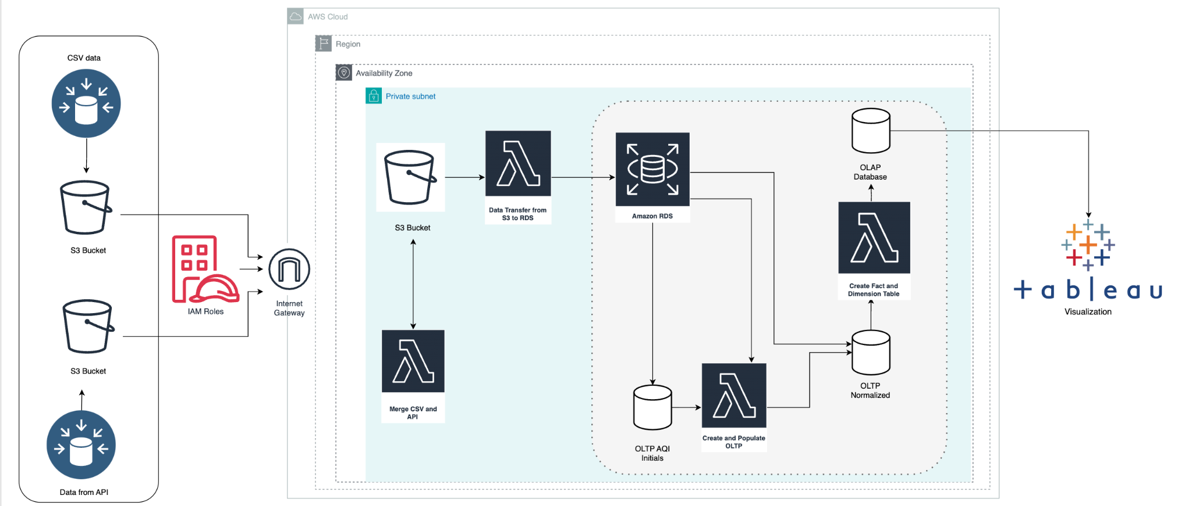
AWS Architecture Diagram

Slide 8
DATA DICTIONARY OF AQI
Column Name | Description | Category
location_id | Identifier for the location where the air quality data was collected. | Numerical
date_local | The date of the air quality measurement in local time. | Categorical
AQI | The Air Quality Index (AQI) value representing the AQI for each pollutant. | Numerical
1st Max Value | The highest recorded concentration value for the specified parameter. | Numerical
1st Max Hour | The hour when the highest concentration value was recorded. | Numerical
Arithmetic Mean | The average concentration of the specified parameter over the given date. | Numerical
state_code | Code representing the state where the location is located. | Categorical
county_code | Code representing the county where the location is located. | Categorical
latitude | The latitude coordinates of the location. | Numerical
longitude | The longitude coordinates of the location. | Numerical
state_name | The name of the state where the location is located. | Categorical
country_name | The name of the country where the location is located. | Categorical
city_name | The name of the city where the location is located. | Categorical

Slide 9
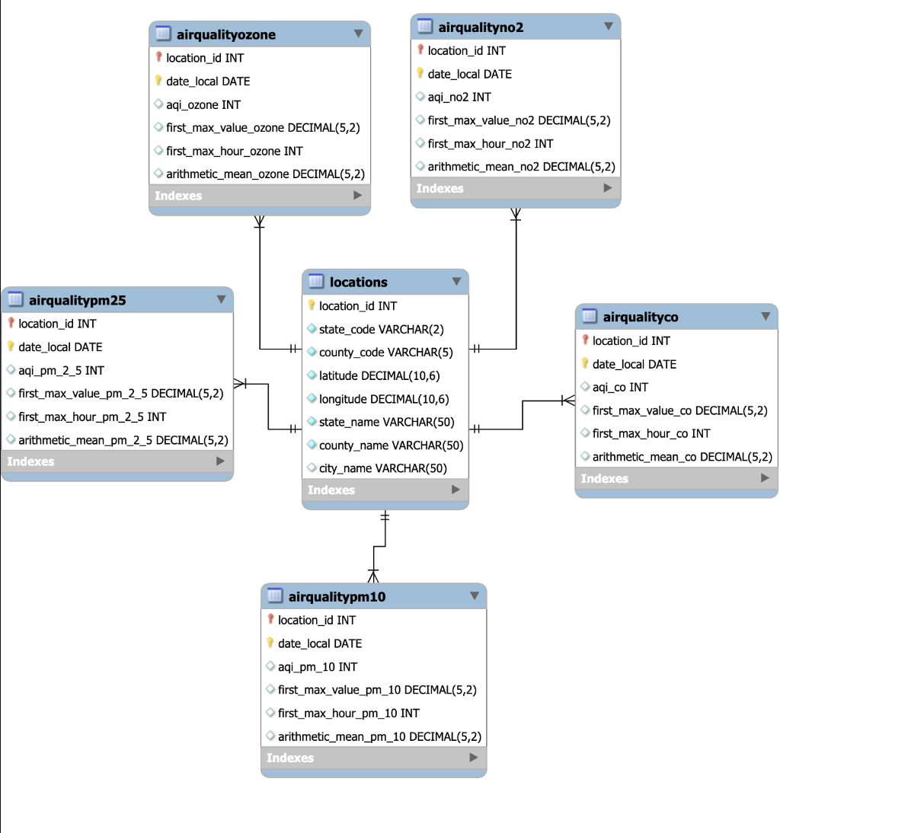
Entity Relationship Diagram

Slide 10
Data Model Summary: Daily Air Quality Analysis
Grain: Daily level; each record in the fact table represents air quality measurements for a each parameter at a particular location for one day.
Dimensions:
Time Dimension: Attributes include Date Local, Day of the Week, Month, and Year.
Location Dimension: Attributes cover geographical details like State Code, County Code, Latitude, Longitude, State Name, County Name, and City Name.
State Dimension - State Code , State Name
Air Quality Fact: Core measurements include AQI, 1st Max Value, 1st Max Hour, and Arithmetic Mean for each pollutant

Slide 11
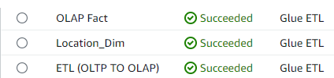
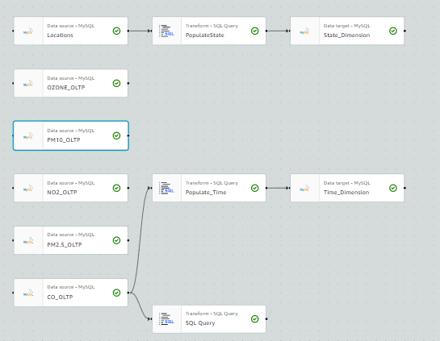
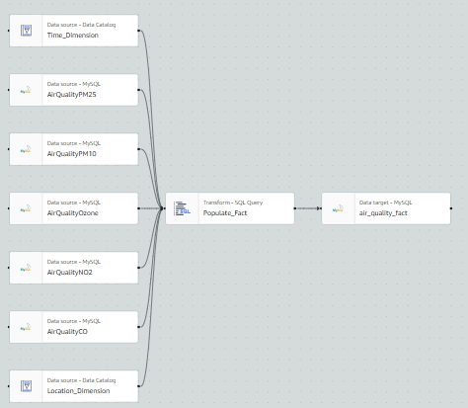
ETL Diagram AWS Glue
Phase I
Phase II

Slide 12
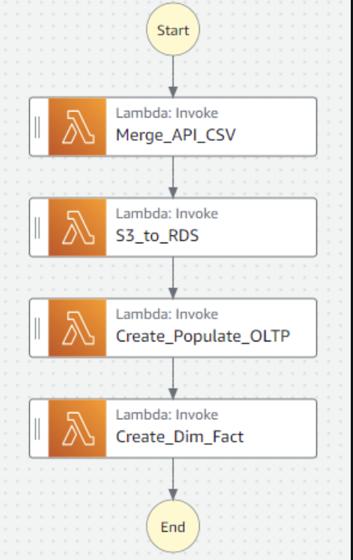
Step Functions
Start: Represents the starting point of the workflow
Lambda Function I: This step invokes a Lambda function called Merge_API_CSV. It merges API and CSV data.
Lambda Function II: This step invokes a Lambda function called S3_to_RDS which transfers data from an S3 bucket to an RDS database.
Lambda Function III: This step invokes a function called Create_Populate_OLTP. This function creates and populates Normalized OLTP.
Lambda Function IV: This step invokes a Lambda function called Create_Dim_Fact. This creates Dimension and Fact Tables.
End:Represents the ending part of the workflow

Slide 13
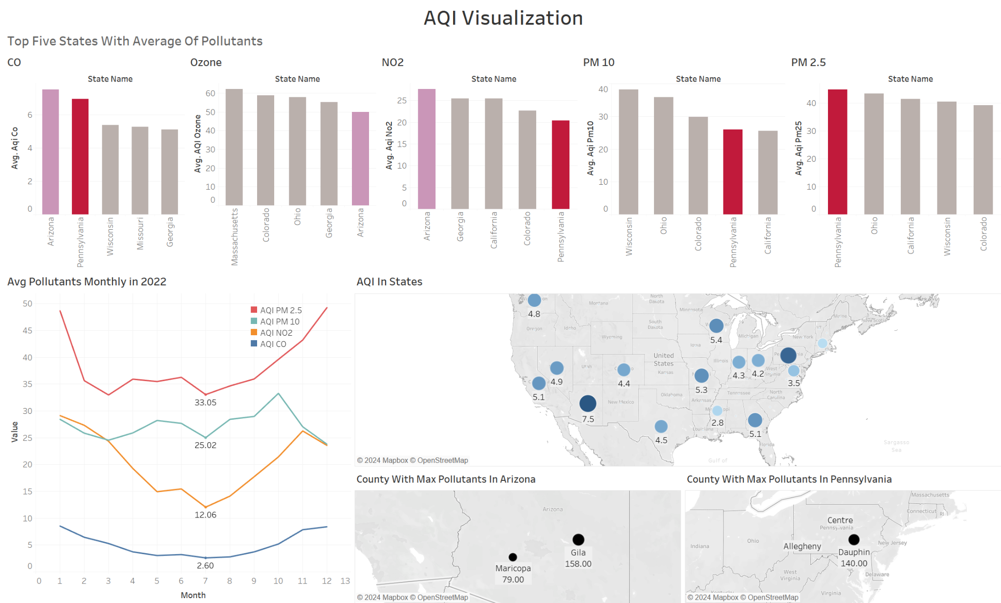
Data Visualization Using Tableau

Slide 14
Conclusion
Our analysis of U.S. air quality revealed concerning trends and valuable insights. By leveraging AWS and rigorous data exploration, we identified Arizona as a state with consistently high levels of all measured pollutants (CO, NO2, PM2.5, PM10, and Ozone). Pennsylvania, while appearing in the top 5 for all pollutants, stood out for particularly high PM2.5 levels, likely due to industrial activity.
Seasonal patterns emerged, with pollution peaking in winter (December-February) and dipping in summer (June-August). This likely reflects colder temperatures trapping pollutants in winter, while summer brings warmer air and sunshine that helps disperse them. Notably, the highly concerning PM2.5 remained elevated throughout the year, with a concerning December spike. Specific locations within Arizona (Gila County) and Pennsylvania (Dauphin County) were identified as having the highest overall pollution levels in 2022.
Moving forward, integrating machine learning models and expanding data collection efforts present exciting opportunities for further refinement. Overall, this project underscores the power of data-driven approaches in tackling environmental challenges and informing decisions for a healthier future.

Slide 15
Lessons Learned
AWS Lambda:
Batch Processing: Divide tasks into smaller batches for efficient processing within the 15-minute limit.
Code Optimization: Enhance Lambda function performance and reduce resource usage through code optimization.
AWS Glue:
Modular Design: Break down complex ETL jobs into smaller, modular steps for improved performance and troubleshooting.
Query Optimization: Optimize queries within Glue to enhance data analysis speed and efficiency in the OLAP data warehouse.
AWS Step Functions:
Orchestration Power: Orchestrate complex workflows involving multiple AWS services for organized data processing pipelines.
Error Handling: Ensure robust error handling within workflows to prevent issues from impacting the entire pipeline and enable easier recovery.

Slide 16
Challenges Faced During Project Execution
Rate Limit Challenges: The EQS API used for accessing 2022 data had rate limits on data retrieval, necessitating the implementation of mechanisms to address this issue.
Data Format Discrepancies: While the general structure remained consistent, inconsistencies arose between the API and CSV data formats, requiring the addition of extra logic to ensure successful data merging.
Handling Duplicate records: Duplicate records were found within the merged dataset for the same gas, location, and date, each containing different pollutant readings. This situation posed a challenge as it diverged from the expected single value per gas per day per location.
Resource Allocation Struggles: During development, instances occurred where the Lambda function responsible for merging and processing data exceeded its allocated resources (CPU, memory).
ETL Job Hurdles: Occasional slowdowns and failures were experienced in the AWS Glue ETL job, resulting in timeouts.
AWS Lambda Throttling: During development, we encountered instances where the Lambda function responsible for data processing exceeded its allowed rate of API calls.

Slide 17
Improvements
API calls can be implemented using AWS Lambda.
AWS SageMaker integration can be explored for developing ML models to enhance complex data visualizations.
Expanding the dataset to include additional years can improve pattern and trend analysis.
AWS QuickSight can be utilized for streamlined data visualization.
CloudWatch can be employed for monitoring purposes.

Slide 18

Project Demo

